Slide 1
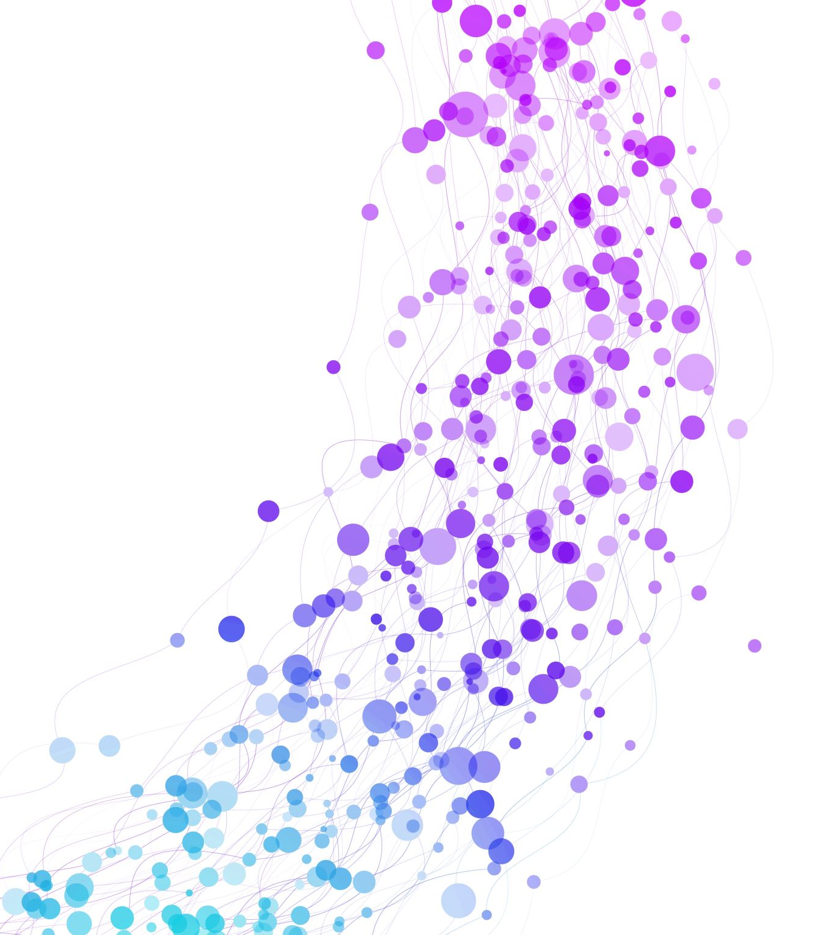
Rock Paper Scissors in JS
By: Ayush Vora
NP Hack Club 2020

Slide 2
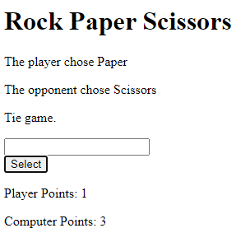
Final Product
https://oddballlovelyactionscript.theyushinator.repl.co/

Slide 3
Step 1: Brainstorming
Set up HTML
Randomize Computer Selection
Identify Player Selection
Check for Improper Inputs
Calculate Winner
Display Score and Reset Input

Slide 4
Step 2: Setting up HTML
We want a heading, 3 paragraph tags, an input box, a select button, and 2 more paragraphs
Give the elements that will change an ID
On click, the button should run a function

Slide 5
Step 3: Randomize Computer Selection
Create array with possible options
Randomly select one of the options (index 0-2)
Later, we will display the computer selection to the HTML page

Slide 6
Step 4: Identify Player Selection
Collect the value that the player inputted
Check to see if the input is valid
Example: Rock, rock, ROCK, r, R

Slide 7
Step 4.5: Display Results So Far
If the user has valid inputs…
Have the first <p> say what the user selected
Have the second <p> say what the computer selected
Otherwise…
Notify the user of the error and list possible inputs
Reset the input field
“return” → end the function

Slide 8
Step 5: Calculate Results
Two options:
Set up 3 long if statements that are looking for the winner
Set up a nested if statements to determine every outcome
Option 1 would be easier in this case

Slide 9
Step 6: Display Winner and Update Score
Create point variables (outside the function)
Add 1 to the winner’s score
Update HTML with winner
Update scoreboard

Slide 10
Step 7: Troubleshooting
Are there any errors in your code?
Troubleshooting tips:
When testing a part of your code, comment other things out
Display a value using console.log()
Only change a few things at a time to identify the issue
Share with others in case they also run into a similar issue

Slide 11
Step 8: Customize
Now that you are finished, make it your own!!! Examples:
Different theme instead of Rock Paper Scissors
CSS to make the web page more fancy
Add pictures
Change the game mechanics (Modify it into another game, like Double-O-Seven/007)
Make it 2-player
Whatever else you want; it’s your game!

Slide 12
Congratulations!
You just make a game using HTML and JS. Go ahead and share it with your friends and family
We would also love to see them on the #projects channel on Discord! :)

